Slide 1

Knowledge Management in Support of Data Intensive Scientific Computing
Paulo Pinheiro da Silva
University of Texas at El Paso
(paulo@utep.edu)
Invited Talk at Pacific Northwest National Laboratory on May 11, 2010

Slide 2
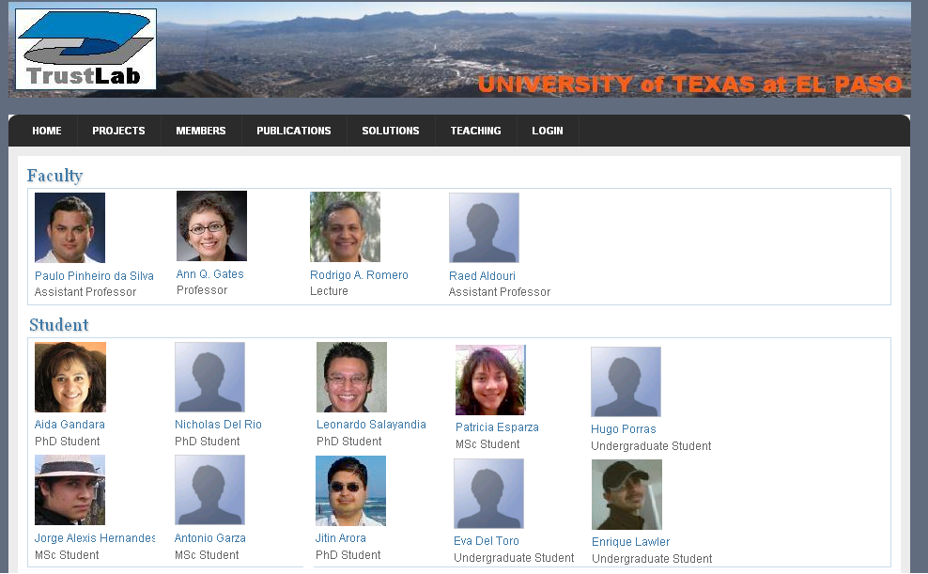
UTEP Trust Lab
http://trust.utep.edu

Slide 3
Motivation (1)
“Recommendation 5 : All researchers should make research data, methods, and other information integral to their publicly reported results publicly accessible in a timely manner to allow verification of published findings and to enable other researchers to build on published results, (…)”
    (Ensuring the Integrity, Accessibility, and Stewardship of Research Data in the Digital Age, Committee on Ensuring the Utility and Integrity of Research Data in a Digital Age; National Academy of Sciences, 2009)

Slide 4
Motivation (2)
“The purpose of Data.gov is to increase public access to high value, machine readable datasets generated by the Executive Branch of the Federal Government. “
(http://www.data.gov/about)
“As a priority Open Government Initiative for President Obama's administration, Data.gov increases the ability of the public to easily find, download, and use datasets that are generated and held by the Federal Government. Data.gov provides descriptions of the Federal datasets (metadata), information about how to access the datasets, and tools that leverage government datasets. The data catalogs will continue to grow as datasets are added. Federal, Executive Branch data are included in the first version of Data.gov.”
(http://www.data.gov/about)

Slide 5

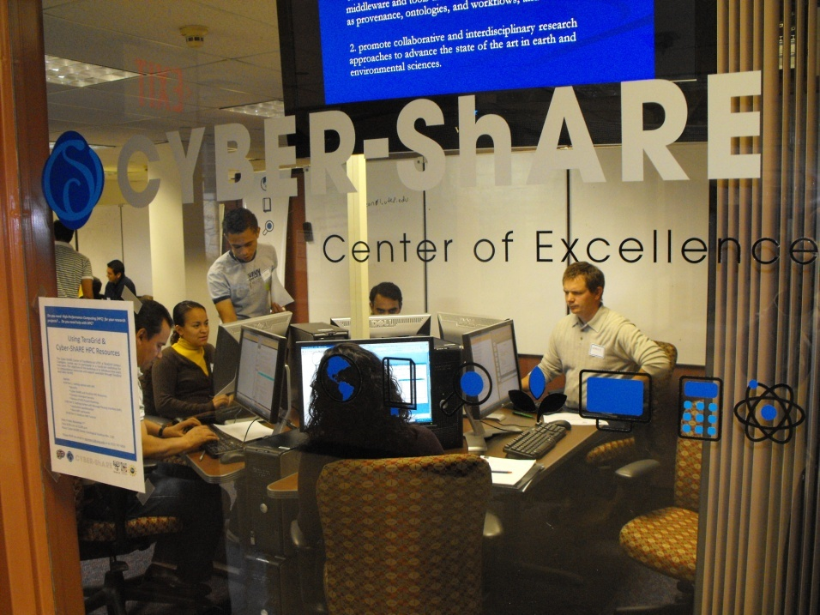
Established at UTEP in 2007 with NSF funding
Focused
  Cross-disciplinary research in science, engineering, and technology at UTEP
  Training workshops on using cyberinfrastructure
  Education and outreach
  Resource acquisition and sharing (documentation of processes)

Slide 6
Overview
Motivation
Knowledge Enhanced Science
Knowledge Enhanced Scientific Collaboration
Evaluations
Conclusions

Slide 7
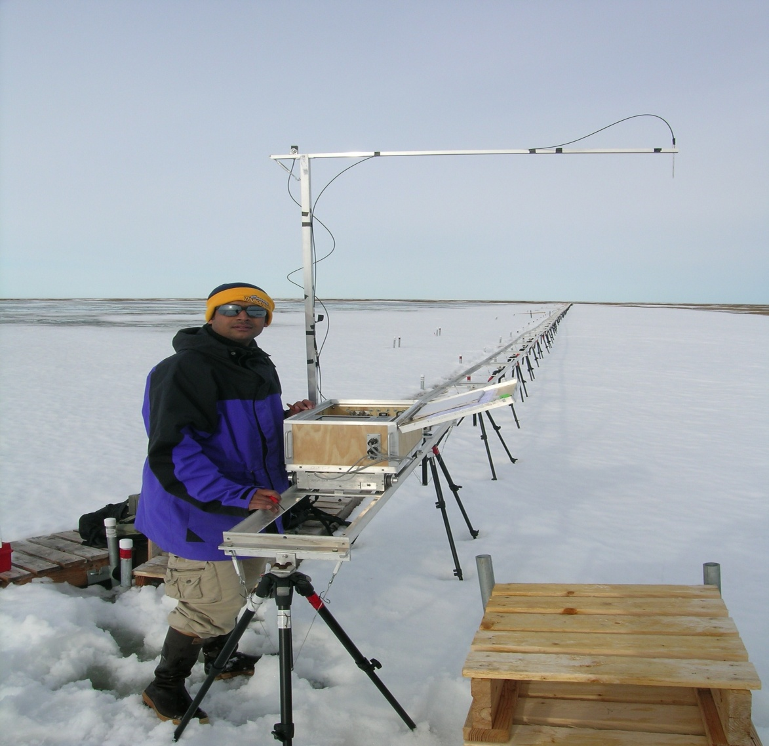
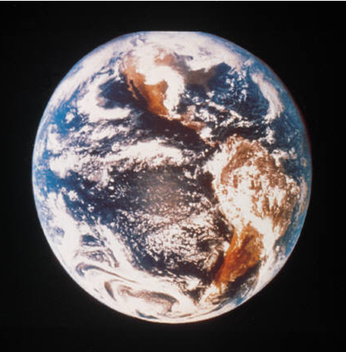
KNOWLEDGE ENHANCED SCIENCE

Slide 8
Working premise
(from Peter Fox’s presentation)
Scientists – actually ANYONE - should be able to access a global, distributed knowledge base of scientific data that:
  appears to be integrated
  appears to be locally available
But… data and information is obtained by multiple means (instruments, models, analysis) using various (often opaque) protocols, in differing vocabularies, using (sometimes unstated) assumptions, with inconsistent (or non-existent) meta-data. It may be inconsistent, incomplete, evolving, and distributed
And… there exist(ed) significant levels of semantic heterogeneity, large-scale data, complex data types, legacy systems, inflexible and unsustainable implementation technology…

Slide 9
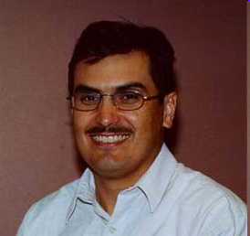
Typical Data Sharing Scenario
Scientific Process
GMG’
How was this map created?
Scientist 1
collaborate
Create based on
GMG
(Gravity Map Generation)
Analyze
Scientific
Result
Scientific Process
GMG”
Scientist 3
(Aaron Velasco)
Scientist 2

Slide 10
Data Sharing: Problem Definition
We often fail to capture, represent and propagate manually generated information that need to go with the data flows
Data is being used in new ways and we frequently do not have sufficient information on what happened to the data along the processing stages to determine if it is suitable for a use we did not envision
Each time we develop a new instrument, we develop a new data ingest procedure and collect different metadata and organize it differently. It is then hard to use with previous projects

Slide 11
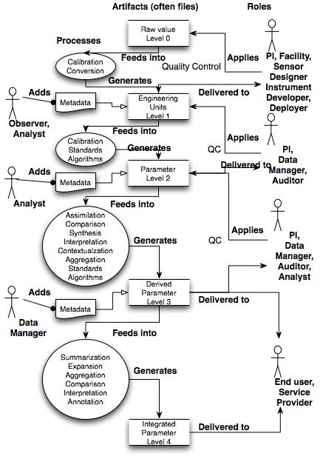
Need to be here
Scientific
Process
Scientific
System
Often ‘get’
the (meta) data here
Too many ‘get’ it here
Notes:
As soon as you even think about semantics and knowledge encoding/ representation, knowledge is everywhere….

Slide 12
Knowledge-Enabled, Machine-Executed Support for Sciences
Scientific
Process
Scientific
Domain
Scientific Processes
Scientific
System
“Knowledge is the expertise, and skills acquired by a person”
(Oxford English Dictionary)
Scientific Systems
Data and Products

Slide 13
Knowledge-Enabled, Machine-Executed Support for Sciences
General-purpose ontologies
Information
integration
Scientific
Domain
Domain Ontologies
Scientific Processes
Task Ontologies
(Abstract Workflow
Specification)
Process
understanding
Process
automation
Scientific Systems
Concrete Workflow
Specification
Provenance
Data and Products
Data and product
discovery/reuse
Product derivation understanding
Data
curation
Data and product acceptance
Data and product attribution

Slide 14
Use Cases
Analyze
Determine which interpolation algorithm was applied to the gravity map derived from measurements collected on January, 26, 2005 around 2100UT by gravitometer J12001.
Which interpolation algorithm was applied to the set of gravity maps derived from measurement collected during the period November 1, 2004 to February 28, 2005?
How many different data product types can be generated from the PACES Gravity Database?
Why does this gravity map look bad?

Slide 15




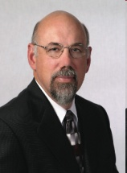
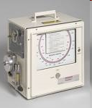
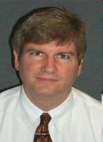
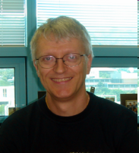

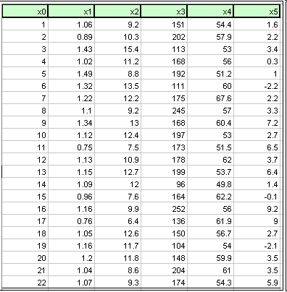

Provenance: A Required Partial Solution for Data Sharing
What are the sources for this map?
How accurate is this map?
isMemberOf
hasCreator
isMemberOf
isMemberOf
Can I trust that this is a quality map?
hasAgent
isMemberOf
hasSource
hasCreator
hasCreator
hasAntecedent
isConsequentOf
(http://utep.edu/myDataSet.xls)
(http://utep.edu/myGravityMap.gif)

Slide 16
Provenance: A Required Partial Solution for Data Sharing
How accurate is this map?
How accurate is this sensor?
isMemberOf
hasCreator
isMemberOf
isMemberOf
Can I trust that this is a quality map?
hasAgent
isMemberOf
hasSource
hasCreator
hasCreator
hasAntecedent
isConsequentOf
(http://utep.edu/myDataSet.xls)
How reliable is this tool?
(http://utep.edu/myGravityMap.gif)

Slide 17
Provenance
General-purpose ontologies
Information
integration
Scientific
Domain
Domain Ontologies
Scientific Processes
Task Ontologies
(Abstract Workflow
Specification)
Process
understanding
Process
automation
Scientific Systems
Concrete Workflow
Specification
Provenance
Provenance
Data and Products
Data and product
discovery/reuse
Data and product
discovery/reuse
Product derivation understanding
Product derivation understanding
Data
curation
Data
curation
Data and product acceptance
Data and product acceptance
Data and product attribution
Data and product attribution

Slide 18
Provenance: A Required Partial Solution for Data Sharing
isMemberOf
hasCreator
isMemberOf
isMemberOf
hasAgent
isMemberOf
hasSource
hasCreator
hasCreator
hasAntecedent
isConsequentOf
(http://utep.edu/myDataSet.xls)
(http://utep.edu/myGravityMap.gif)

Slide 19
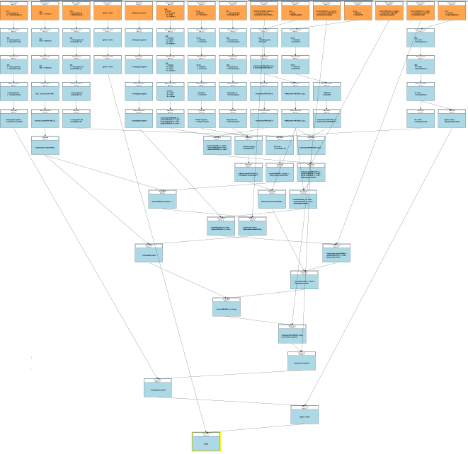
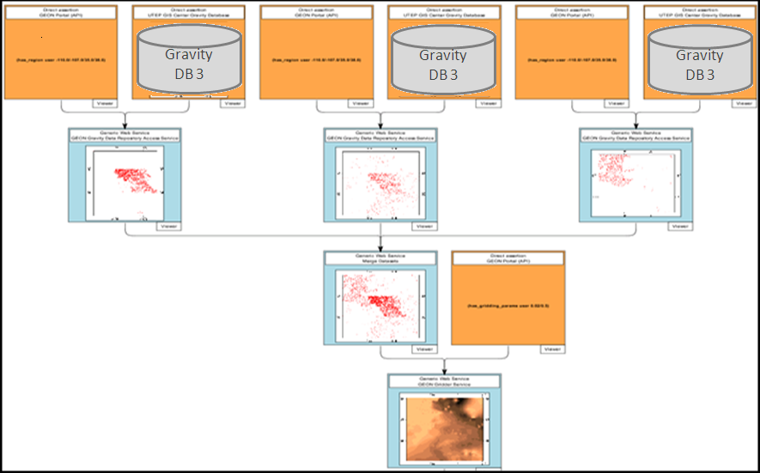
Product Derivation Provenance
Provenance Information tell us where the data used to derive the map came from and how the map was derived

Slide 20
PML: A Provenance Representation Language
Organization
Organization
Organization
Organization
isMemberOf
hasCreator
isMemberOf
isMemberOf
Person
hasSource
Sensor
Person
Person
isMemberOf
hasSource
hasCreator
hasCreator
Organization
hasAntecedent
isConsequentOf
Information
Software
Information
(http://utep.edu/myDataSet.xls)
(http://utep.edu/myGravityMap.gif)

Slide 21
PML: A Provenance Representation Language
PML-P Module
Three modules: provenance (pml-p), justification (pml-j), trust
PML vocabulary inherited from proof theory, e.g., inference step, antecedent, consequent
Thing
Identified Thing
Organization
Source
isMemberOf
Agent
PML-J Module
Sensor
Person
Thing
Node Set (hasConclusion,
)
hasSource
Inference
Engine
hasCreator
Web
Service
hasAntecedent
InferenceStep ( ,
hasInferenceEngine,
hasInferenceRule,
)
isConsequentOf
Document
Software
Information
Database
Data Set
Ontology
InferenceRule
Publication
DeclarativeRule
Website
MethodRule

Slide 22
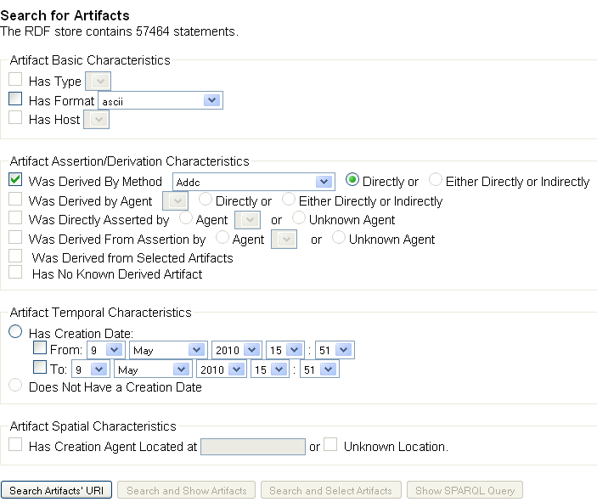
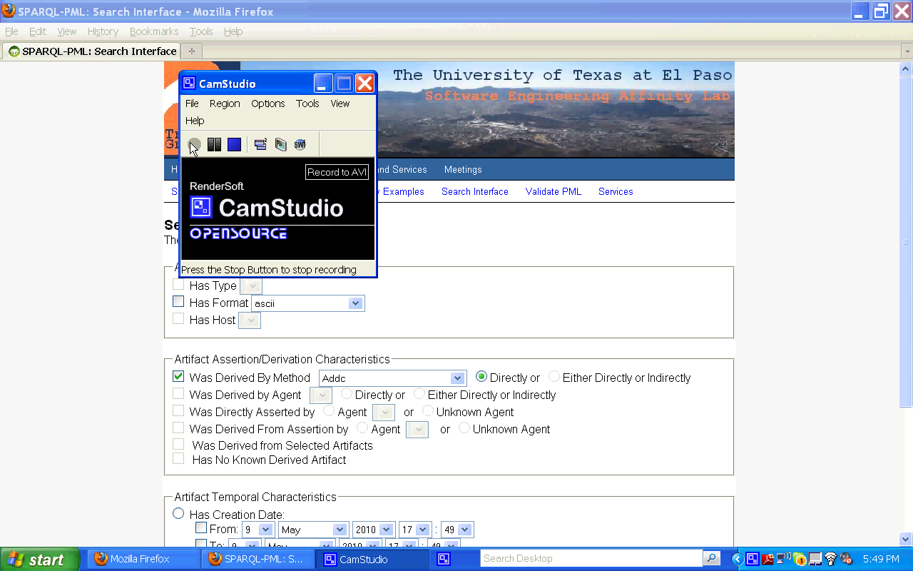
Provenance Support for Product and Data “Discovery”

Slide 23
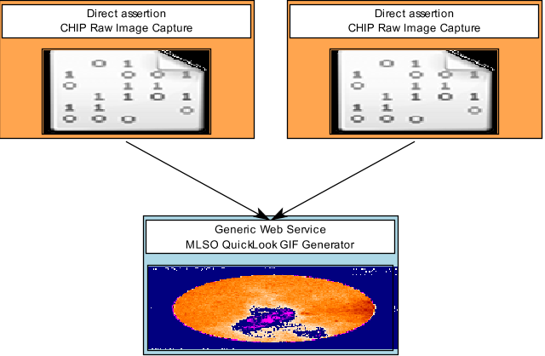
Provenance Support for Product and Data Discovery (1/2)
Question:
List artifacts that are either asserted by CHIP or derived from information asserted by CHIP.
SPARQL-PML Query:
SELECT ?a
WHERE {?a rdf:type pmlj:NodeSet .
?a pmlj:isConsequentOf ?uhs1.
?uhs1 pmlj:hasSourceUsage ?uhs2.
?uhs2 pmlp:hasSource <http://iw.vsto.org/registry/SEN/CHIP.owl#CHIP>. }
A
B
C
(more examples of sparql-pml queries available at http://trust.utep.edu/sparql-pml/query/example)

Slide 24
Provenance Support for Product and Data Discovery (2/2)
Question:
List artifacts in GIF format and that are either asserted by CHIP or derived from information asserted by CHIP.
SPARQL-PML Query:
SELECT ?a
WHERE {
?a rdf:type pmlj:NodeSet .
?a pmlj:hasConclusion ?b .
?b pmlp:hasFormat
<http://iw.vsto.org/registry/FMT/GIF.owl#GIF>.
?a pmlj:isConsequentOf ?uhs1.
?uhs1 pmlj:hasSourceUsage ?uhs2.
?uhs2 pmlp:hasSource
<http://iw.vsto.org/registry/SEN/CHIP.owl#CHIP>. }
C

Slide 25
Scientific
Process
Scientific
System

Slide 26
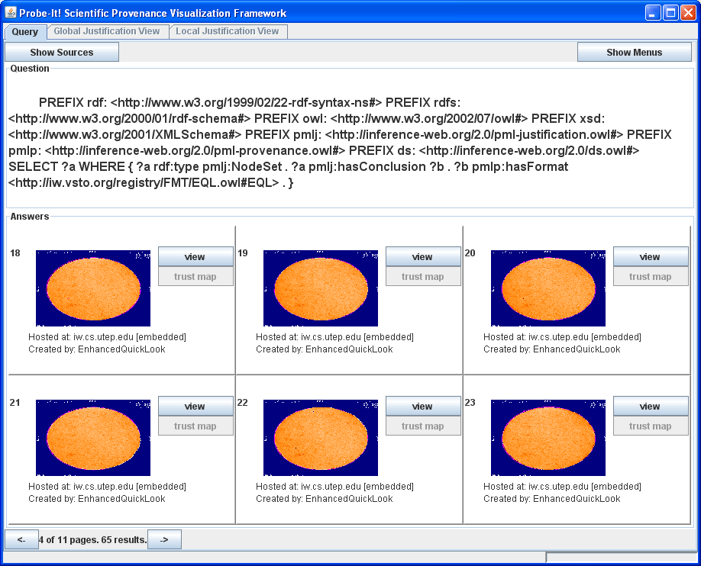
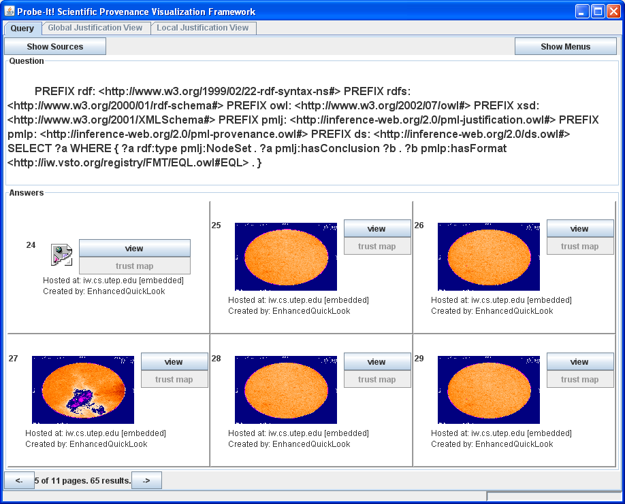
Probe-It!: Provenance Visualization

Slide 27
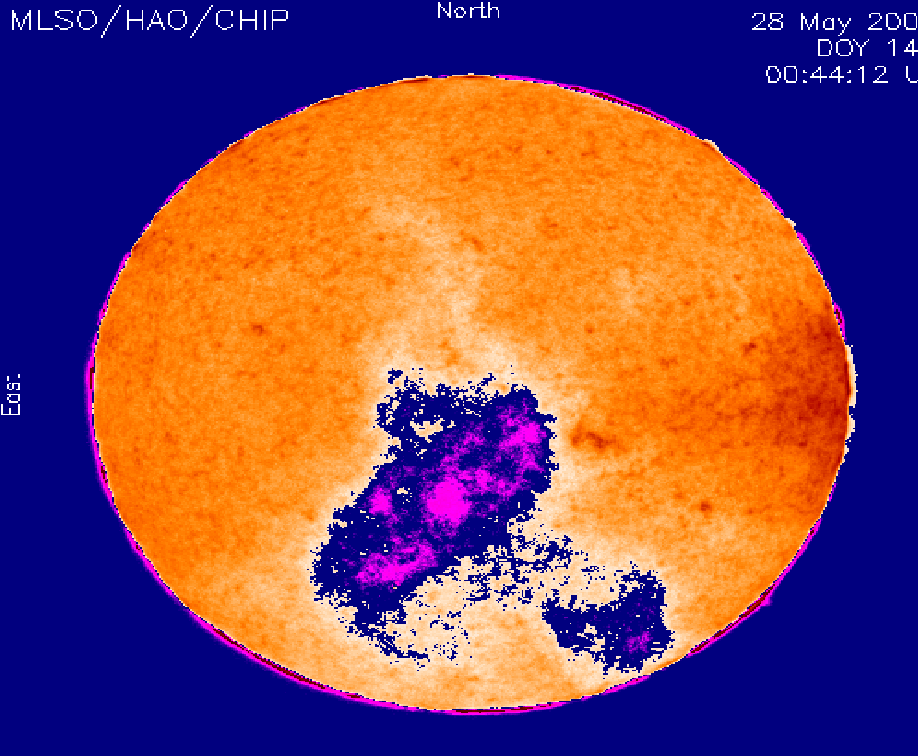
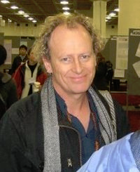
Original MLSO Quicklook Process
Why does this image look bad?

Slide 28
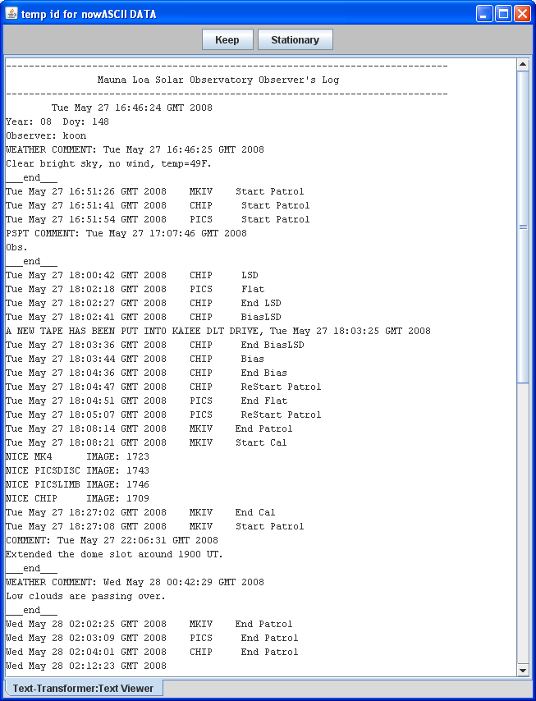

Slide 29
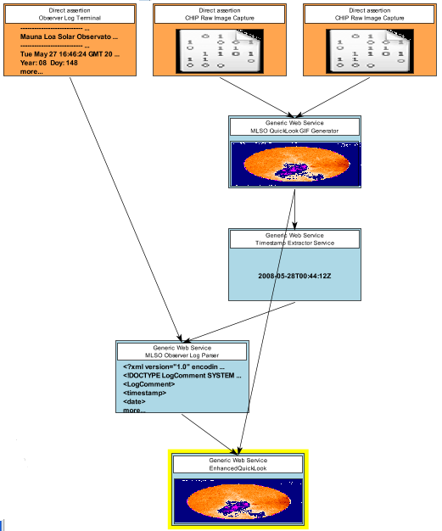
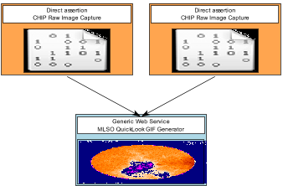
Enhanced QuickLook Process
Observer Log
Original QuickLook
Image timestamp
Timestamp-related
comments
Enhanced QuickLook

Slide 30
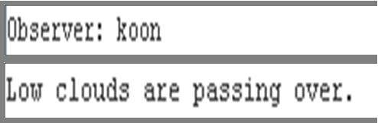
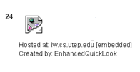
Enhanced QuickLook
Why does this image look bad?
Why is the ACOS CHIP image from March 21, 2008, 1900UT missing?

Slide 31
Need to be here
Scientific
Process
Scientific
System
Often ‘get’
the (meta) data here
Too many ‘get’ it here
Notes:
As soon as you even think about semantics and knowledge encoding/ representation, knowledge is everywhere….

Slide 32

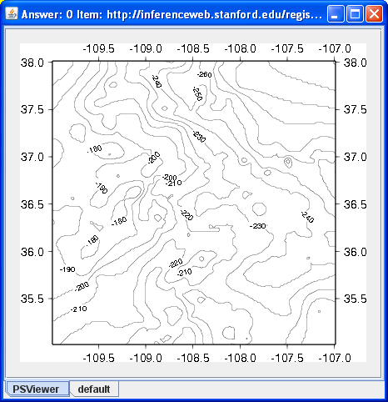
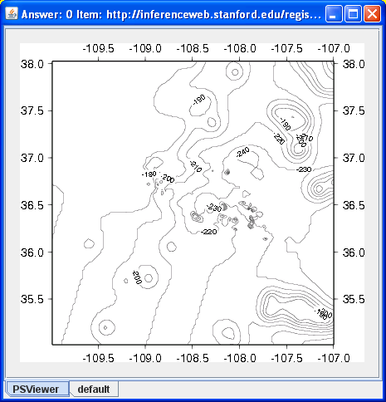
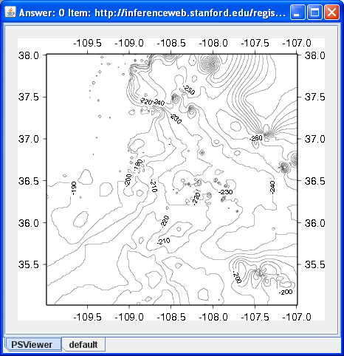
Provenance Support for Product Derivation Understanding
Possible
imperfections
We need to know how these maps were generated
in order to assess their quality

Slide 33
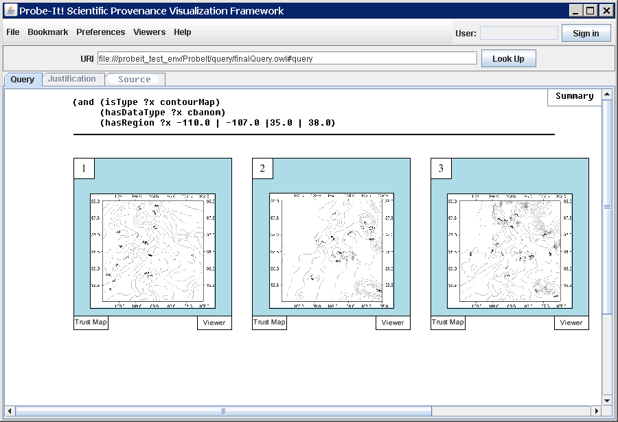
We use the results and their provenance summaries to
form a belief about the quality of a map
To verify our belief, we evaluate the maps’ justification
(i.e., provenance) and see if we can find reasons to
support our claims
S1: UTEP S1: UTEP S1: UTEP
S2: USGS S2: da Silva Data S2: USGS
S3: da Silva Data
Common Source

Slide 34

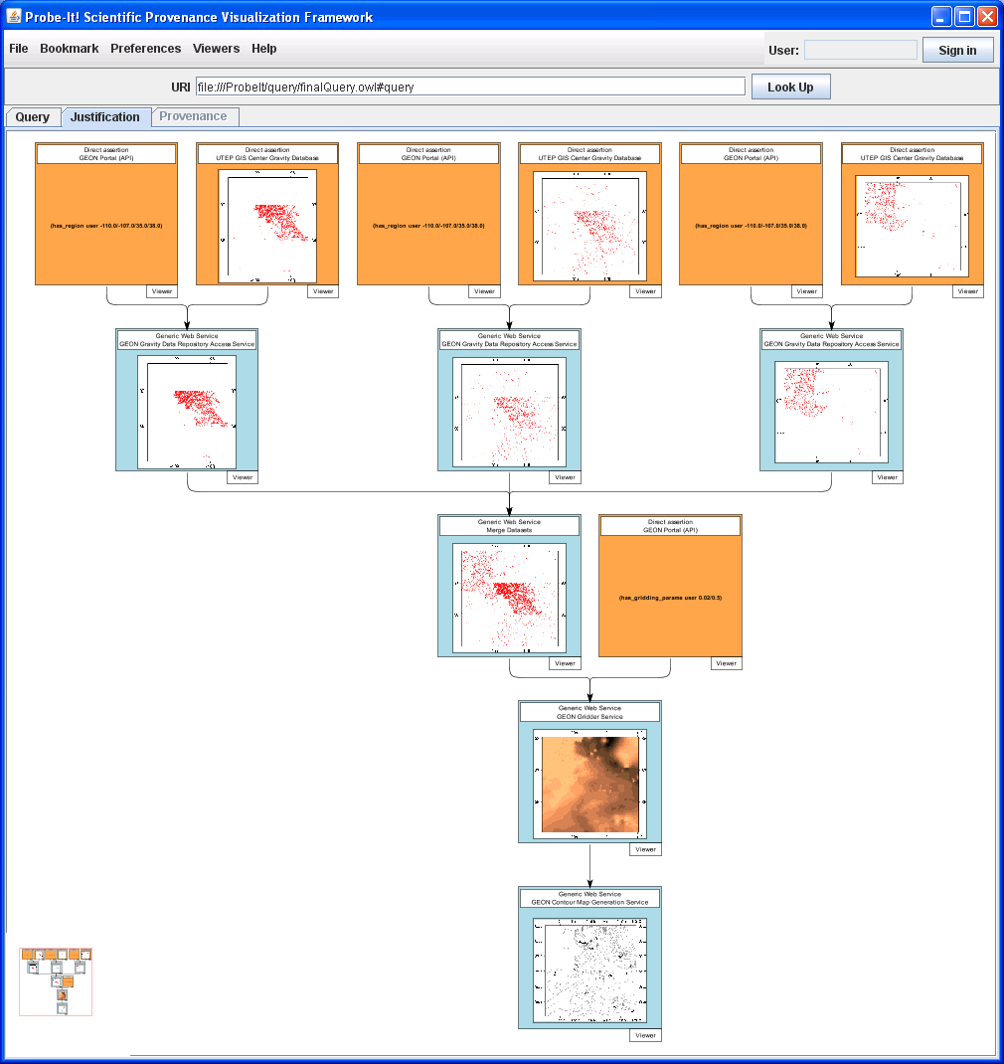
S1: UTEP S1: UTEP S1: UTEP
S2: USGS S2: da Silva Data S2: USGS
S3: da Silva Data

Slide 35
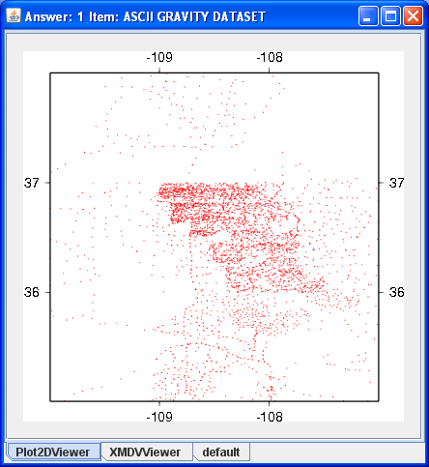
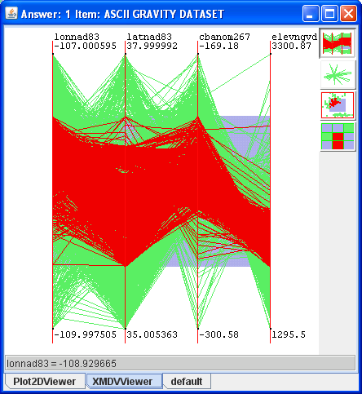
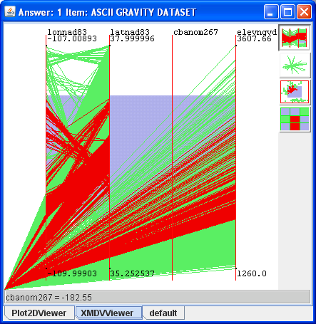
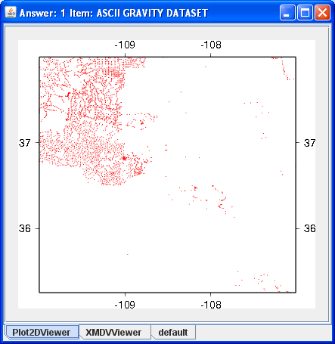
No variance!
We verified our belief by finding a bad source
S1: UTEP S1: UTEP S1: UTEP
S2: USGS S2: da Silva Data S2: USGS
S3: da Silva Data

Slide 36


Identifying products derived from sensors, services, data
A provenance query:
  How many different data product types can be generated from the ACOS CHIP instrument?
Other provenance queries:
  How many products at my organization and elsewhere have been affected by this incorrect calibration image?
  How many products have been affected by this faulty sensor?
  Which products have been affected by this faulty sensor?

Slide 37
General-Purpose (Upper-Level) and Domain Ontologies, Concrete Workflows
General-purpose ontologies
General-purpose ontologies
Information
integration
Information
integration
Scientific
Domain
Domain Ontologies
Domain Ontologies
Scientific Processes
Task Ontologies
(Abstract Workflow
Specification)
Process
understanding
Process
automation
Process
automation
Scientific Systems
Concrete Workflow
Specification
Concrete Workflow
Specification
Provenance
Data and Products
Data and product
discovery/reuse
Product derivation understanding
Data
curation
Data and product acceptance
Data and product attribution

Slide 38
What is an Ontology?
(Slide from Deborah McGuinness)
Thesauri
“narrower
term”
relation
General
Description
Logics
Formal
taxonomy
Frames
(properties)
Catalog/
ID
Term Hierarchy (e.g. Yahoo!)
Formal
instance
General Logic
Terms/
glossary
Value Restrs.
*based on AAAI ’99 Ontologies panel – Gruninger, Lehmann, McGuinness, Uschold, Welty
Updated by McGuinness, additional input from Gruninger, Uschold, and Rockmore

Slide 39
Knowledge (Ontology) Enabled
Data Integration and Reasoning
Ontologies let us merge statements from different sources
Ontologies let us derived conclusions from statements coming from different sources
myOntology
#Richland
hasPopulation
46,155
myOntology
#Richland
hasPopulationChange
(10 years)
hasEstimatedPopulation
(10 years)
hasPopulationChange
(10 years)
19.2%
55,016

Slide 40
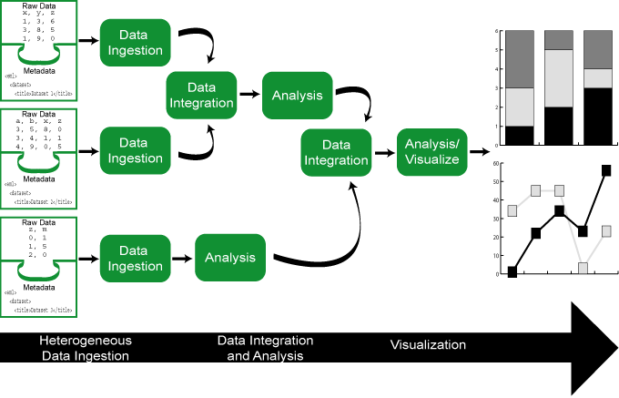
Scientific Workflow
(Slide from Bertram Ludäscher)
Capture how a scientist works with data and analytical tools
  data access, transformation, analysis, visualization
  possible worldview: dataflow-oriented (cf. signal-processing)
Scientific workflow (wf) benefits (compare w/ script-based approaches) :
  wf automation
  wf & component reuse
  wf design, documentation
  wf archival, sharing
  built-in concurrency
  (task-, pipeline-parallelism)
  built-in provenance support
  distributed execution
  (Grid) support
  …
http://daks.ucdavis.edu/~ludaesch/Paper/presentations.html#SDM

Slide 41
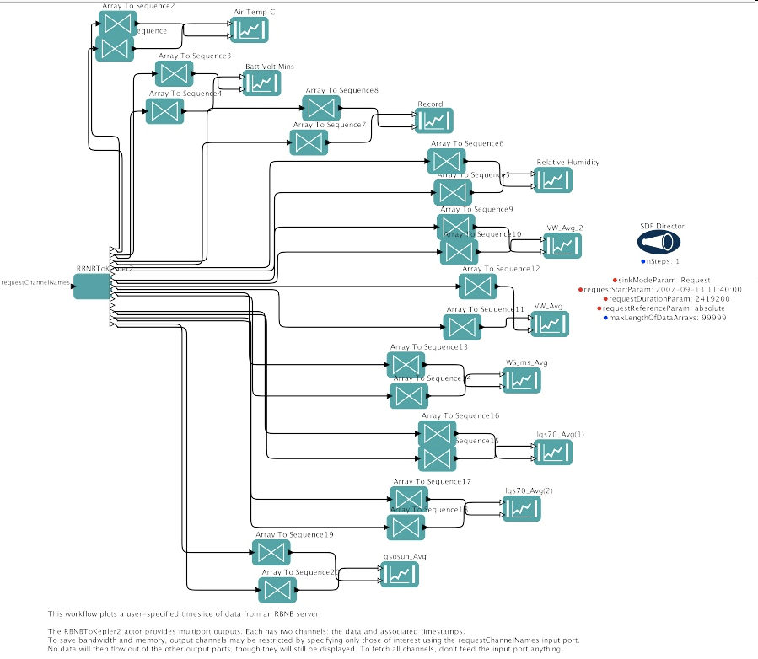
Scientific Workflows and Provenance Capture
Scientific
Process
?
  One needs to understand scientific processes to capture provenance
Traditional scientific workflow tools would be natural candidates to explain scientific processes
Scientific
System

Slide 42
Abstract Semantic Workflow
General-purpose ontologies
Information
integration
Scientific
Domain
Domain Ontologies
Scientific Processes
Task Ontologies
(Abstract Workflow
Specification)
Task Ontologies
(Abstract Workflow
Specification)
Process
understanding
Process
understanding
Process
automation
Scientific Systems
Concrete Workflow
Specification
Provenance
Data and Products
Data and product
discovery/reuse
Product derivation understanding
Data
curation
Data and product acceptance
Data and product attribution

Slide 43
Documenting Scientific Processes with Ontologies and Abstract Workflows
Purpose
  Identify appropriate vocabulary for a scientific community
  Model a scientist’s understanding of a process
  Identify the parts of a process that are of interest to scientists
Benefits
  Share scientist’s understanding of a process with others
  Guide the development of systems that implement scientist’s understanding of a process
  Enhance existing systems to provide functionality aligned to scientist’s understanding of a process

Slide 44
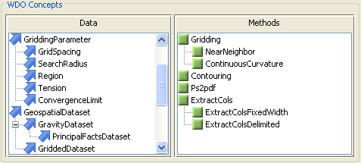
Documenting Scientific Processes with Ontologies and Abstract Workflows
Phase1: Capture the vocabulary of the process in a Workflow-Driven Ontology (WDO)
  WDOs have two main classes:
    Data, e.g., Gridded Dataset, Elevation Map
    Method, e.g., Nearest-neighbor extrapolation
  Tool support to construct WDOs
    Encoded in OWL
    Reuse vocabulary from other OWL ontologies
    Generate HTML reports
Method
Outputs
Data
Data
is input to
Method

Slide 45
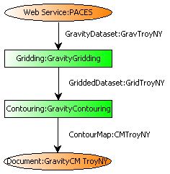
Documenting Scientific Processes with Ontologies and Abstract Workflows
Phase2: Model the process as a Semantic Abstract Workflow (SAW)
  Dataflow modeling
  Graphical representation
  Multiple levels of abstraction supported
  Tool support to create SAWs
    Encoded in OWL
    Generate HTML reports
    Generate provenance-capturing modules

Slide 46
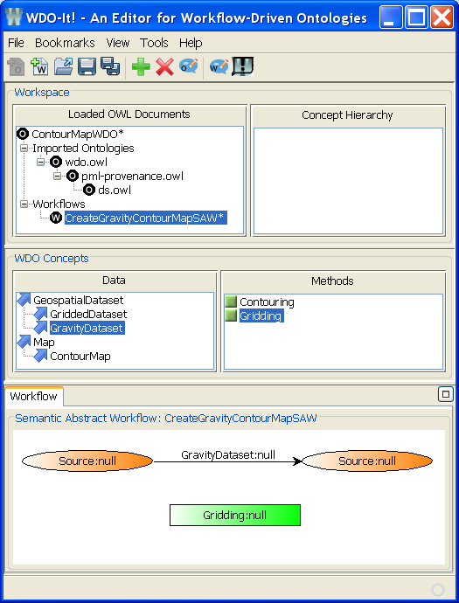
Documenting Scientific Processes with Ontologies and Abstract Workflows
WDOs and SAWs are intended to be authored by Scientists
  Scientist-centered level of abstraction
  Dataflow modeling intended to facilitate process modeling

Slide 47
Provenance, SAW and WDO
The framework:
  Process and Provenance ontology alignment
    PML: Identify things that can be used to document how things happened (i.e., provenance)
    SAW: Identify things that can be used to document how things can happen (i.e., process)
PML-P Module
PML-J Module
Thing
Thing
Node Set
Identified Thing
InferenceStep
Information
InferenceRule
Source
DeclarativeRule
Agent
Document
MethodRule
WDO
Thing
Data
Method
Source

Slide 48
SAW Support for PML Acquisition
Abstract Workflows
Abstract workflows are used to create provenance links
Gravity
Readings
Gravity
Map
sensor
Generate
Gravity Map
filesystem
isConsequentOf
(http://utep.edu/myDataSet.xls)
(http://utep.edu/myGravityMap.gif)

Slide 49

Semantic Annotations
Summary
Scientific Process
GMG’
Ontology
Abstract
Workflow
How was this map created?
GMG
Scientist 1
collaborate
Create based on
GMG
Analyze
Provenance
Scientist 3
Scientific
Product
Scientific Process
GMG”
Scientist 2

Slide 50
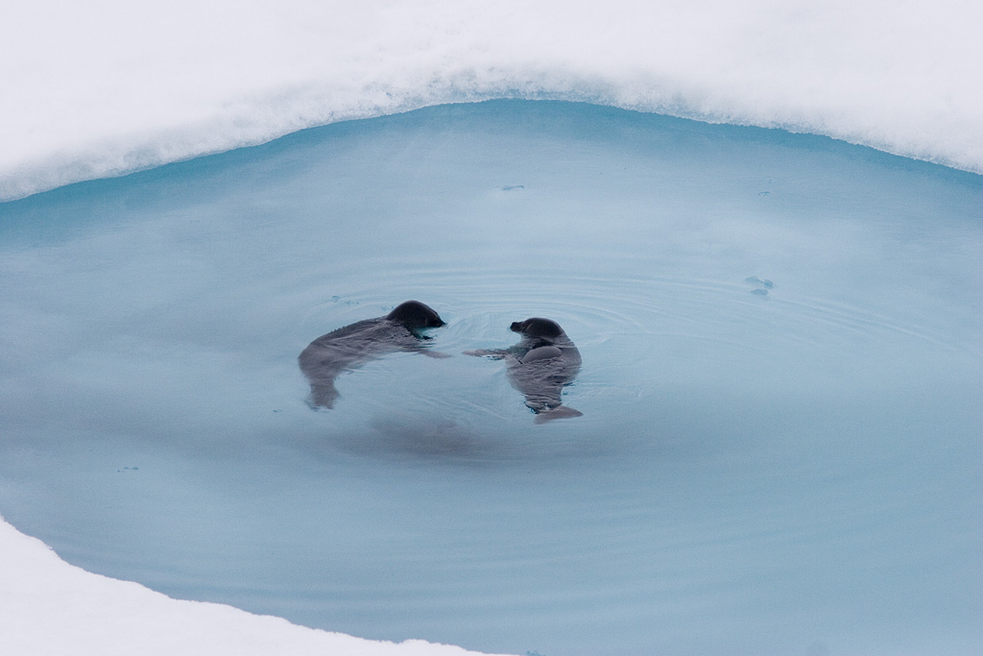
Knowledge Enhanced Scientific COLLABORATION

Slide 51

Collaboration
Trust Network Knowledge
Team A Team B
Team A
Team B
General-purpose ontologies
General-purpose ontologies
Scientific
Domain
Domain Ontologies
Scientific
Domain
Domain Ontologies
Scientific Processes
Task Ontologies
(Abstract Workflow
Specification)
Scientific Systems
Concrete Workflow
Specification
Scientific Processes
Task Ontologies
(Abstract Workflow
Specification)
Collaboration
Infrastructure
Scientific Systems
Concrete Workflow
Specification
Data and Products
Provenance
Data and Products
Provenance

Slide 52
Collaboration Infrastructure Challenges
Started building collaborative tools: 2 issues
  1. Data Access
    Stored on local systems
    Shared via e-mail
    Uploaded to a portal
  2. Discussions about data
    E-mail
    In-person Meetings
    Chat
    Social networking site
Data stored in environments that do NOT support any knowledge about its contents (e.g. OWL docs)
∴ This makes discussing data a challenge
Collaboration
Infrastructure

Slide 53
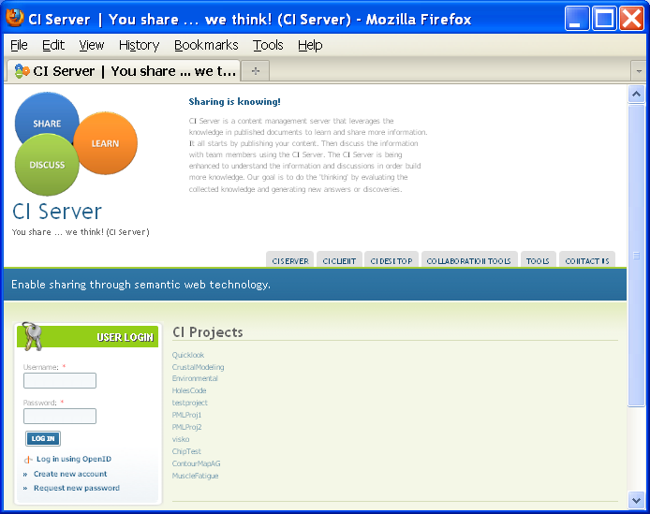
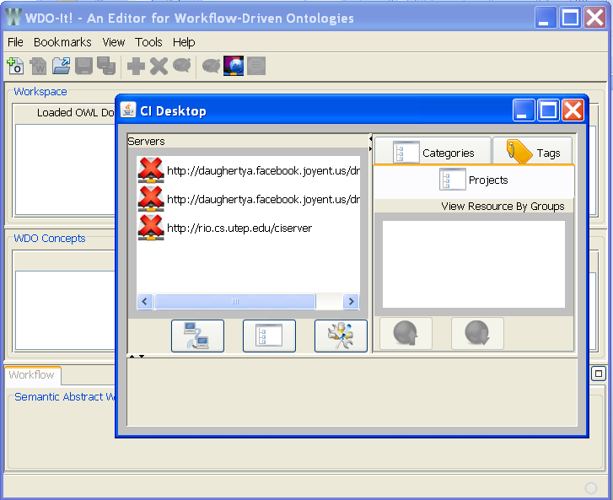
CI-Server/CI-Client
CI-Server
Publish content (resources)
Privacy support
Collect comments about data
Relate comments to data
Services available to interact with site
Keep link between data and discussions
Build a collective knowledge of semantically annotated data
Enable reasoning about semantic in data
Privacy support for groups
CI-Client
API/widgets that interface with CI-Server services
Embed in client tools
Support access to server knowledge from inside client tool (user context)
Access to multiple servers
Portal independent
Enable context-related push of content/data
Enable context-related collaboration
Enable portal information integration

Slide 54
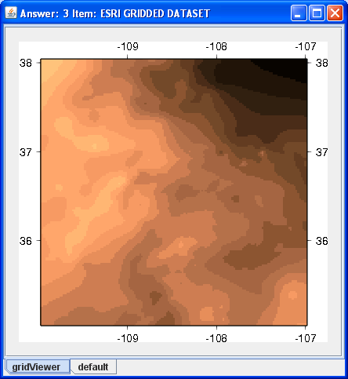
Trust Support for Provenance
Can I trust that this is a quality map?
isMemberOf
hasCreator
isMemberOf
isMemberOf
hasAgent
isMemberOf
hasSource
hasCreator
hasCreator
hasAntecedent
isConsequentOf
(http://utep.edu/myDataSet.xls)
(http://utep.edu/myGravityMap.gif)

Slide 55
Trust Network
A Definition
A trust network is a couple (A, R) such that A is a set of agents and R is an A × A→ [0,1]². For every a and b in A we write
  R(a,b) = (R⁺(a,b),B⁻(a,b))
Lets build a trust network for geoscientists…

Slide 56
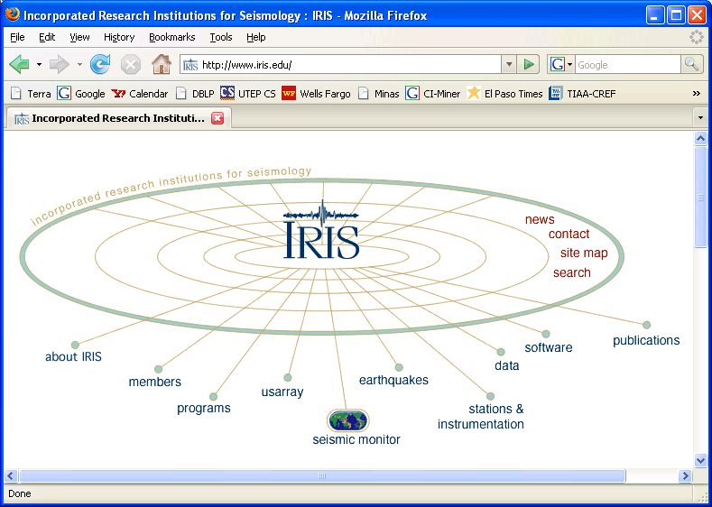
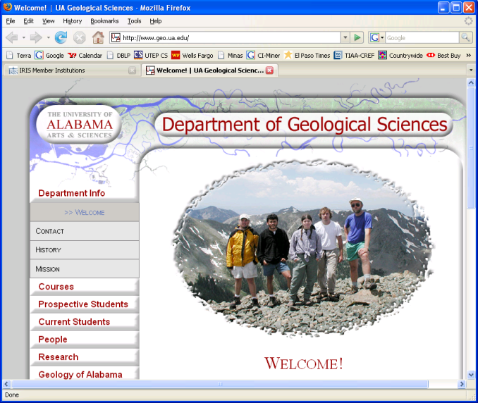
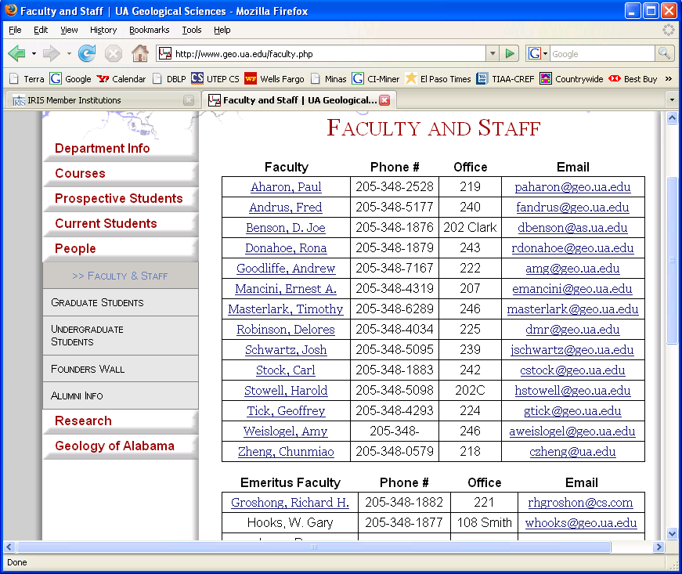
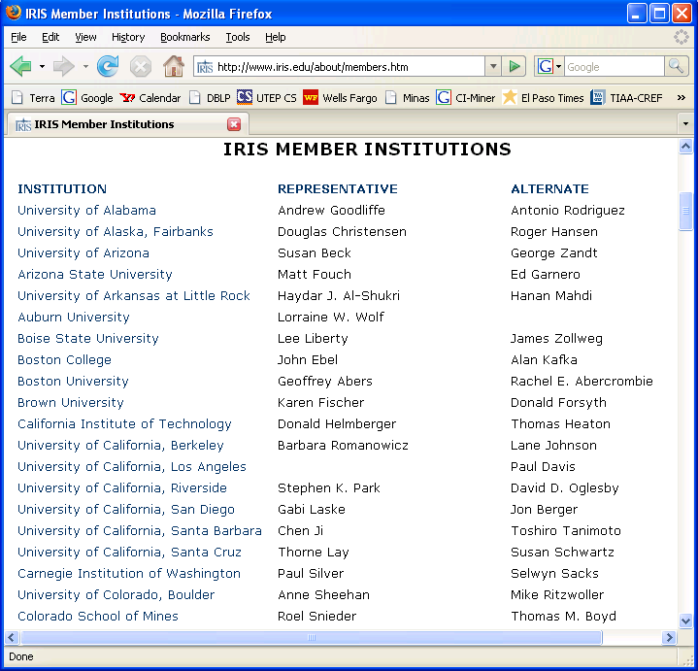
Extracting a Social Network for Geosciences
In collaboration with:
A. Castañeda - UTEP
Topic-specific
crawler
Web
HLRT wrapper
for organization
HLRT wrappers
for people
Organization
(pmlp)
Person
(pmlp)
CI-Learn-It is a framework for systematic execution of topic-driven crawlers and wrappers
CI-Learn-It may be reused for extracting social networks in other domains
Where can we find trust relations R() for these agents?

Slide 57
Trust Relations (1/2)
In the gravity domain, U1 may have no trust opinion about S1, S2 and S3
U1 may have no opinion at all about S1, S2 and S3
U1 (Aaron)
t(U1,S1,grav)=0.9
t(U1,S2,grav)=0.9
t(U1,S3,grav)=0.8
S2
S3
S1 (Randy)
asserts
asserts
asserts
Since S1, S2 and S3 are sources of the same kind of information, chances are that they are active information sources in a given domain, e.g., gravity
Further, chances are that S1, S2 and S3 collaborate, e.g., by writing publications, submitting grants, attending meetings, citing each other’s papers, etc. → evidences of trust relations
f₀=f(0.0)=1.0
f₁=f(1.0)=1.3
f₂=f(2.0)=0.9
0.0
1.0
2.0

Slide 58

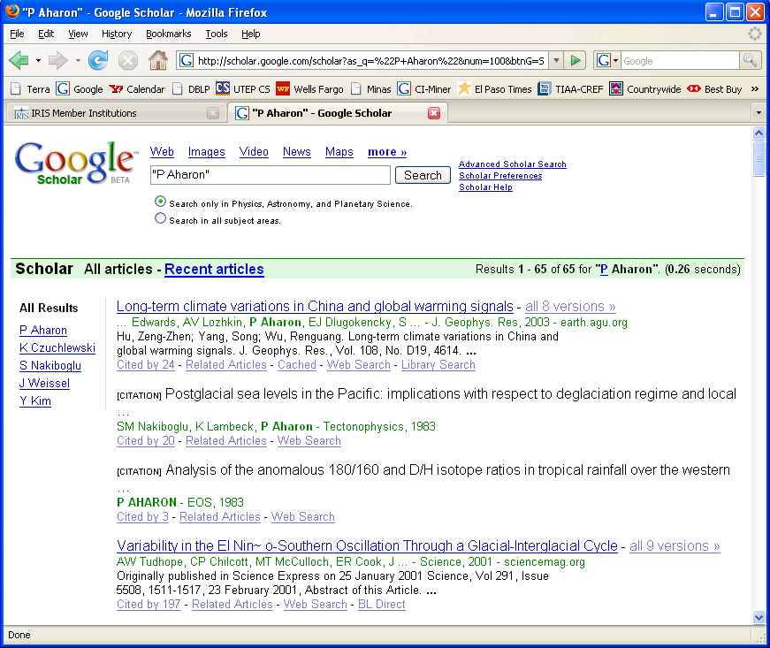
Trust Relations (2/2)
Co-authorship may identify trust relations among scientists regarding sciences
P. Aharon
Trustee Trusted
#Co-Author-ship
Edwards Lozhkin
Edwards Aharon
Lozhkin Edwards
Lozhkin Aharon
Aharon Edwards
Aharon Lozhkin
1
1
1
1
1
1

Slide 59
Provenance and Trust
PML-P Module
Thing
An agent may trust another agent
Identified Thing
Information
Source
An agent may be inclined to believe a document if the agent trusts the creator(s) of the document
Agent
Organization
PML-J Module
Sensor
Person
Thing
Software
Node Set (hasConclusion,
isConsequentOf)
Inference
Engine
hasCreator
Web
Service
InferenceStep ( hasAntecedent,
hasInferenceEngine,
hasInferenceRule)
Document
Database
Data Set
Ontology
InferenceRule
Publication
DeclarativeRule
Website
MethodRule

Slide 60
EigenTrust [Kamvar et al., 2003]
S3
S1
S2
s₁₂=1, s₂₁=1, s₁₃=2, s₃₁=2, s₂₃=1, s₃₂=1
c₂₁=0.5, c₁₃=0.67, c₃₁=0.67, c₂₃=0.5, c₃₂=0.33
t₂₁ = 0.33, t₁₃=0.16, t₃₁=0.16, t₂₃=0.33, t₃₂=0.22

Slide 61
EigenTrust (cont’.)
If C = [c_{ij}] and t_{i} the vector containing the values of t_{ij} then t_{i} = C^{T}c_{i}
Probabilistic interpretation:
  “If an agent were searching for reputable peers, it can crawl the network using the following rule: at each peer i, it will crawl to peer j with probability c_{ij} . After crawling for a while in this manner, the agent is more likely to be at reputable peers than unreputable peers.”

Slide 62
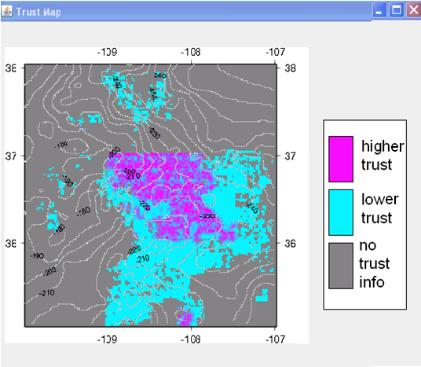
Trust Support for Provenance
Can I trust that this is a quality map?
Can I believe that this is a genuine gravity feature?
(http://utep.edu/myGravityMap.gif)

Slide 63
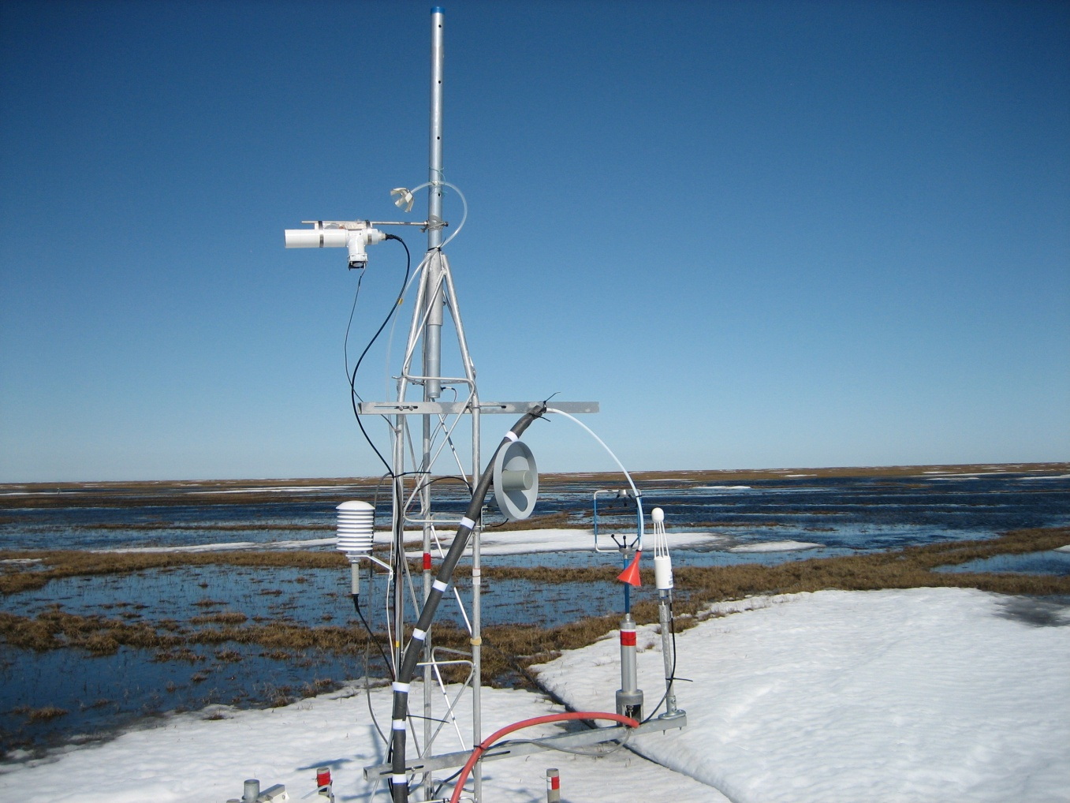


Evaluations

Slide 64
Provenance (PML) Case Studies
Information extraction –IBM (UIMA), Stanford (TAP)
Information integration – USC ISI (Prometheus/Mediator); Rutgers University (Prolog/Datalog)
Task processing – SRI International (SPARK/CALO)
Theorem proving
  Portable proofs across reasoners: JTP (with temporal and context reasoners (Stanford); CWM (W3C), SNARK(SRI), KM (University of Texas, Austin), JEOPS (Univ. of Fortaleza)
  SATisfiability Solvers – University of Trento (J-SAT)
  More than 30 theorem provers through TPTP (University of Miami, FL)
Service composition - Stanford, University of Toronto, UCSF (SNRC)
Semantic matching – University of Trento (S-Match)
Scientific provenance
  University of Texas at El Paso (GEON, CEON, EarthScope)
  Rensselear Politechnic Institute ; National Center for Atmospheric Research (VSTO, SPCDIS, SESDI)
Intelligence analysts’ tools - PNNL, IBM, Stanford (NIMD/KANI)
Border Security (UTEP/DHS-Scientific Leadership)
Learning systems
  Procedure learning (TAILOR, LAPDOG, / CALO)
  Integrated learning systems (GILA)
Privacy policy law validation (TAMI)
Trust in social collaborative networks (Wikipedia TrustTab)
PML- A single provenance approach that has been used in multiple diversified areas

Slide 65


Provenance Experiments: User Studies
Hypothesis:Scientists with access to provenance can identify
and explain the quality of maps more accurately than scientists
without access to provenance
50+ subjects:
The results indicate that our hypothesis is correct; there was a significant difference between the mean accuracy of results provided by scientists when accessing provenance and when not accessing provenance*
*Significance was verified using a two sample t-test at 95% confidence
Identification Task
Explanation Task

Slide 66






Documenting Scientific Processes with Ontologies and Abstract Workflows
Scientific Process |  | Abstract Workflow | Provenance
Name | Domain
Holes Code | Earth science | done | done
Crustal Model | Earth science | done | under develop.
CEON Reflectance | Environmental science | done | under development
Jornada Antenna | Environmental science | under develop.
Cargo Inspection | Homeland security |  | done
Quicklook | Solar physics | done | done
MLSO CHIP | Solar physics | under develop.
TPTP | Artificial intelligence |  | done
Some efforts where WDOs and SAWs are being used
Environmental data collection at
La Jornada Experimental Range (LTER)
The arctic region (Barrow, Alaska)
Seismic refraction experiments at Potrillo mountains

Slide 67






Conclusions

Slide 68
Accomplishments
myOntology
#Richland
46,155
Information
integration
55,016
19.2%
Process
understanding
Data and product
discovery/reuse
PML-P Module
Thing
Process
automation
Identified Thing
General-purpose ontologies
Scientific
Domain
Information
Domain Ontologies
Source
Scientific Processes
Agent
Task Ontologies
(Abstract Workflow
Specification)
Document
Scientific Systems
PML-J Module
Thing
Concrete Workflow
Specification
Node Set
Product derivation understanding
Provenance
Data
curation
Ontology
Data and Products
Abstract
Workflow
InferenceStep
InferenceRule
GMG
DeclarativeRule
MethodRule
Data and product acceptance
Data and product attribution
Provenance
Scientific
Product

Slide 69
Software/Knowledge Products
Web technology
  Moving scientific contents from silos (personal laptops and desktops) to the web without losing privacy
    Content management [CI-Server/CMS] (with Aida and Patricia)
  Being able to share content but also to support discussions about the content
    Collaboration support [CI-Client/CI-Desktop/WFTalk] (with Aida)
Semantic Web technology
  Link documents logically
    Provenance [PML notation, PML API] (with Deborah, Peter, and many others)
    Abstract workflows [WDO & SAW notations, WDO-It] (with Leonardo and Ann)
  Understand and use linked documents
    Visualization [Probe-It, VisKo] (with Nicholas, Hugo)
    Search [CI-Server/Triple Store] (with Jitin)
Uncertainty management [TrustMap] (with Vadik, Christian)
Applications
  Cargo Inspection [CargoTrust] (with Nicholas, Alexis, Hugo, Henrique and Raed)

Slide 70
Some Open Questions
Do we share our data/products?
Do we annotate our data/products?
How easy is for someone else to reuse our data/products/annotations?
  How easy is to find our data/product?
  How was that data/product derived?
  How easy is to understand the scientific process behind a product/data?
How can we get credit for collecting/curating data?
  How can we give credit to someone else for collecting/curating data that we use?
How do we believe someone’s data/product?
How do we trust other scientists?
_{http://trust.utep.edu}

Slide 71





PML in Action
PML provides a Web-based solution for provenance distribution
  schema defined using W3C’s Ontology Web Language (OWL)
  PML is defined at the level of the following:
    Queries
    Node Sets
    Inference Steps
  queries and node
  sets are identified
  by URIs
hasAntecedents
Inference
step
hasInferenceRule
One node set can have multiple inference steps, i.e., justifications, that share the same conclusion
hasInferenceEngine
node set
hasConclusion
One query can have multiple answers
hasAnswer
http://.../contour.owl#map
query
hasContent
http://.../contour_query.owl#query

